Slide 1





DIAGNOSTIC CENTER
Team Members:
M.ANAND, 203B1A0423
P.PRAVEEN KUMAR, 203B1A0437
G. SATISH KUMAR, 203B1A0415
CH. SUDHEER, 203B1A0408
Guide:
ASWIN KUMAR MOTAPOTHULA

Slide 2
DIAGONSTIC CENTER
OUTLINE
Abstract
Problem Statement
Aims, Objective & Proposed System/Solution
System Design
System Development Approach (Technology Used)
Algorithm & Deployment
Sample Screenshots
Conclusion
Future Scope
References
Video of the Project
Notes:
These are the list of chapters that we are going to cover in these foundation codes. Those are chapter one what are AI and ML? chapter 2 applied Python programming in AI, and chapter 3 is exploratory data analysis for ML.

Slide 3
Abstract
DIAGONSTIC CENTER
This abstract presents the conceptualization and development of a modern diagnostic center management system implemented using HTML, JavaScript, CSS, and MySQL technologies. The web application aims to streamline the operations of a diagnostic center, providing an efficient and user-friendly platform for both healthcare professionals and patients.
The HTML framework forms the structural backbone of the system, defining the layout and content presentation. Responsive design principles are implemented through CSS, ensuring optimal user experience across various devices. JavaScript is utilized to enhance the dynamic aspects of the application, enabling interactive features such as real-time form validation and asynchronous data retrieval.
The integration of MySQL as the backend database system facilitates secure and organized storage of patient records, test results, and other essential information. The abstract explores the database schema, emphasizing the importance of maintaining data integrity and security in a healthcare setting.
User authentication and authorization mechanisms are implemented using a combination of JavaScript and server-side processing, ensuring that only authorized personnel can access sensitive patient information. The abstract also highlights the use of encryption techniques to secure data transmission between the client and server.

Slide 4
Problem Statement
DIAGONSTIC CENTER
In the current healthcare landscape, the integration of online booking systems for diagnostic center services presents a promising avenue for streamlining patient interactions and improving overall service delivery. However, several challenges hinder the seamless adoption and functionality of online booking platforms for diagnostic centers.
Limited Accessibility and Awareness: Many patients, particularly in certain demographics, may face barriers in accessing and navigating online booking platforms. This lack of awareness or digital literacy can impede the widespread adoption of online booking systems, limiting the potential benefits for both patients and diagnostic centers.
Inadequate User Interface and Experience: Existing online booking systems for diagnostic centers often suffer from suboptimal user interfaces and experiences. Complicated navigation, unclear instructions, and non-intuitive design can lead to user frustration, discouraging patients from utilizing the online booking option.
Integration with Existing Systems: Diagnostic centers may encounter challenges integrating online booking systems with their existing appointment management and laboratory information systems. Compatibility issues and data synchronization problems can compromise the accuracy and reliability of the booking process.
4.Security and Privacy Concerns: As online platforms deal with sensitive health information, ensuring robust security measures is paramount. Concerns related to data breaches, unauthorized access, and inadequate encryption can undermine patient trust in utilizing online booking systems.
5.Reservation Scheduling and Overbooking: Efficient allocation of time slots and prevention of overbooking pose significant challenges. Inaccurate scheduling can lead to patient dissatisfaction, longer wait times, and operational inefficiencies within the diagnostic center.

Slide 5
Aim and Objective
DIAGONSTIC CENTER
Aim:
The primary aim of this project is to enhance healthcare accessibility and streamline patient experience by implementing and optimizing an online booking system for diagnostic centers. The project seeks to address existing challenges in traditional appointment scheduling processes and leverage digital technologies to provide a more efficient, user-friendly, and patient-centric method for accessing diagnostic services.
Objectives:
Improve Accessibility:
* Develop an intuitive and user-friendly online booking platform that caters to individuals with varying levels of digital literacy.
* Implement features such as multiple language support and accessible design to ensure inclusivity for a diverse patient population.
Enhance User Experience:
* Design a responsive and visually appealing user interface that simplifies the booking process and provides clear instructions for patients.
*Incorporate user feedback mechanisms to continuously refine and improve the online booking experience based on real-time user interactions.

Slide 6
Ensure Data Security and Privacy:
Implement robust security measures, including encryption protocols and access controls, to safeguard patient information and maintain compliance with healthcare data protection regulations.
Integrate with Existing Systems:
Develop seamless integration mechanisms with the existing appointment management and laboratory information systems within diagnostic centers to ensure accurate scheduling and real-time data synchronization.
Optimize Scheduling Algorithms:
* Implement intelligent scheduling algorithms to efficiently allocate time slots, preventing overbooking and minimizing patient wait times.
Incorporate flexibility in scheduling to accommodate urgent cases and changing diagnostic center capacities.
Provide Technical Support and Training:
* Establish a comprehensive support system for healthcare professionals and patients, offering training resources and responsive technical assistance to ensure smooth adoption and utilization of the online booking system.
Monitor and Evaluate:
* Implement a monitoring and evaluation framework to track the system's performance, user satisfaction, and key performance indicators, allowing for continuous improvement and adaptation based on feedback and analytics.

Slide 7
Proposed Solution
DIAGONSTIC CENTER
User-Centric Interface Design:
Develop a user-friendly and intuitive interface that simplifies the online booking process for patients. Prioritize clear navigation, straightforward form fields, and visual cues to guide users through the booking journey.
Implement responsive design principles to ensure a seamless experience across various devices, including desktops, tablets, and smartphones.
Integrated Security Measures:
Employ advanced encryption protocols and robust access controls to secure patient data and maintain compliance with healthcare privacy regulations (e.g., HIPAA).
Regularly conduct security audits and vulnerability assessments to identify and address potential risks, ensuring the confidentiality and integrity of sensitive health information.
Smart Scheduling Algorithms:
Implement intelligent scheduling algorithms that optimize appointment slots based on factors such as diagnostic test duration, healthcare professional availability, and diagnostic center capacity.
Integrate real-time monitoring to dynamically adjust scheduling parameters, preventing overbooking and efficiently managing the allocation of resources.
Comprehensive Training and Support:
Establish a comprehensive training program for healthcare professionals and administrative staff to familiarize them with the online booking system.

Slide 8
System Architecture
DIAGONSTIC CENTER
+-------------------------------------------+
| Online Diagnostic Center |
+-------------------------------------------+
|
+----------|----------+
| | |
+---v---+ +----v----+ +---v---+
| User | | Web | | Database|
| Interface | Server | | |
+---+---+ +--------+ +--------+
|
+---v---+
|Client |
|Logic |
+---+---+
|
+---v---+
| External |
| Systems |
+---+---+

Slide 9
DIAGONSTIC CENTER
Online Diagnostic Center: Represents the entire system.
User Interface: The interface users interact with (e.g., web pages).
Web Server: Serves the web pages, handles requests, and interacts with the application.
Database: Manages and stores data related to the diagnostic center.
Client Logic: Manages user interactions, performs client-side validations.
External Systems: Represents any external systems the diagnostic center might integrate with.

Slide 10
System Deployment Approach
DIAGONSTIC CENTER
Deploying an online diagnostic center involves ensuring that the developed system is set up and running efficiently for users. Here's a deployment approach for an online diagnostic center using HTML, CSS, JavaScript, and MySQL:
1. Server Setup:
Choose a Hosting Service:
Select a hosting provider based on your requirements (e.g., AWS, Google Cloud, Heroku).
Set up a virtual machine or server instance to host your application.
Install Necessary Software:
Install a web server (e.g., Apache, Nginx) to handle HTTP requests.
Install a MySQL server for database management.
2. Database Deployment:
Export Database Schema:
Export the database schema created during development.
Import into Production Database:
Set up a new database on the production server.
Import the exported database schema.
3. Server-Side Deployment:
Deploy Backend Code:
Transfer the server-side code (Node.js, Express.js, PHP) to the production server.

Slide 11
DIAGONSTIC CENTER
Configure Environment Variables:
Set up environment variables for configurations (e.g., database connection details, API keys).
Install Dependencies:
Install any server-side dependencies using package managers (e.g., npm, Composer).
Start Server:
Start the server application, ensuring it runs on the specified port.
4. Frontend Deployment:
Transfer Frontend Code:
Transfer HTML, CSS, and JavaScript files to the production server.
Update Paths:
Update file paths and URLs to reflect the production environment.
5. Security Measures:
SSL/TLS Configuration:
Implement SSL/TLS certificates to enable HTTPS for secure data transmission.
Firewall Configuration:
Set up a firewall to control incoming and outgoing traffic.
Access Controls:
Restrict access to sensitive directories and files.
6. Testing:
Perform System Testing:
Test the entire system in the production environment.
Check functionality, responsiveness, and data integrity.

Slide 12
7. Backup and Recovery:
Implement Regular Backups:
Set up automated backup processes for both the database and the server-side code.
Recovery Procedures:
Define procedures for data recovery and system restoration in case of unexpected issues.
8. Monitoring:
Implement Monitoring Tools:
Set up monitoring tools to track server performance, traffic, and potential issues.
Logging:
Enable detailed logging to capture events and errors for troubleshooting.
9. User Communication:
Announce Deployment:
Notify users and stakeholders about the deployment schedule and any potential downtime.
10. Post-Deployment Checks:
Verify Functionality:
Perform post-deployment checks to ensure that the system is functioning as expected.
User Acceptance Testing (UAT):
Encourage users to provide feedback and report any issues.

Slide 13
Algorithm & Deployment
DIAGONSTIC CENTER
Algorithm:
User Registration:
Collect and authenticate user details for registration.
Appointment Management:
Enable users to schedule diagnostic appointments securely.
Data Input and Processing:
Allow healthcare professionals to input and process diagnostic test results.
Result Retrieval:
Implement a secure system for users to access and retrieve their diagnostic results.
Notification System:
Set up automated notifications for appointment confirmations and result availability.
Deployment Approach:
Server Setup:
Choose a reliable hosting provider and set up a secure server environment.
Database Deployment:
Deploy a MySQL database, ensuring data integrity and implementing regular backups.
Backend and Frontend Deployment:
Deploy the server-side application (Node.js, Express.js) and transfer frontend files.
Configure SSL/TLS for secure data transmission.

Slide 14
4.Security Measures:
Implement access controls, firewalls, and regular security audits.
5.Testing and User Communication:
Conduct thorough system testing and user acceptance testing.
Communicate deployment schedules and potential downtime to users.
6.Post-Deployment Checks and Documentation:
Verify system functionality post-deployment and address reported issues promptly.
Update user manuals and documentation to reflect any changes.
7.Continuous Monitoring and Maintenance:
Implement monitoring tools for server performance.
Regularly conduct security audits and address bug fixes or implement feature updates based on user feedback

Slide 15
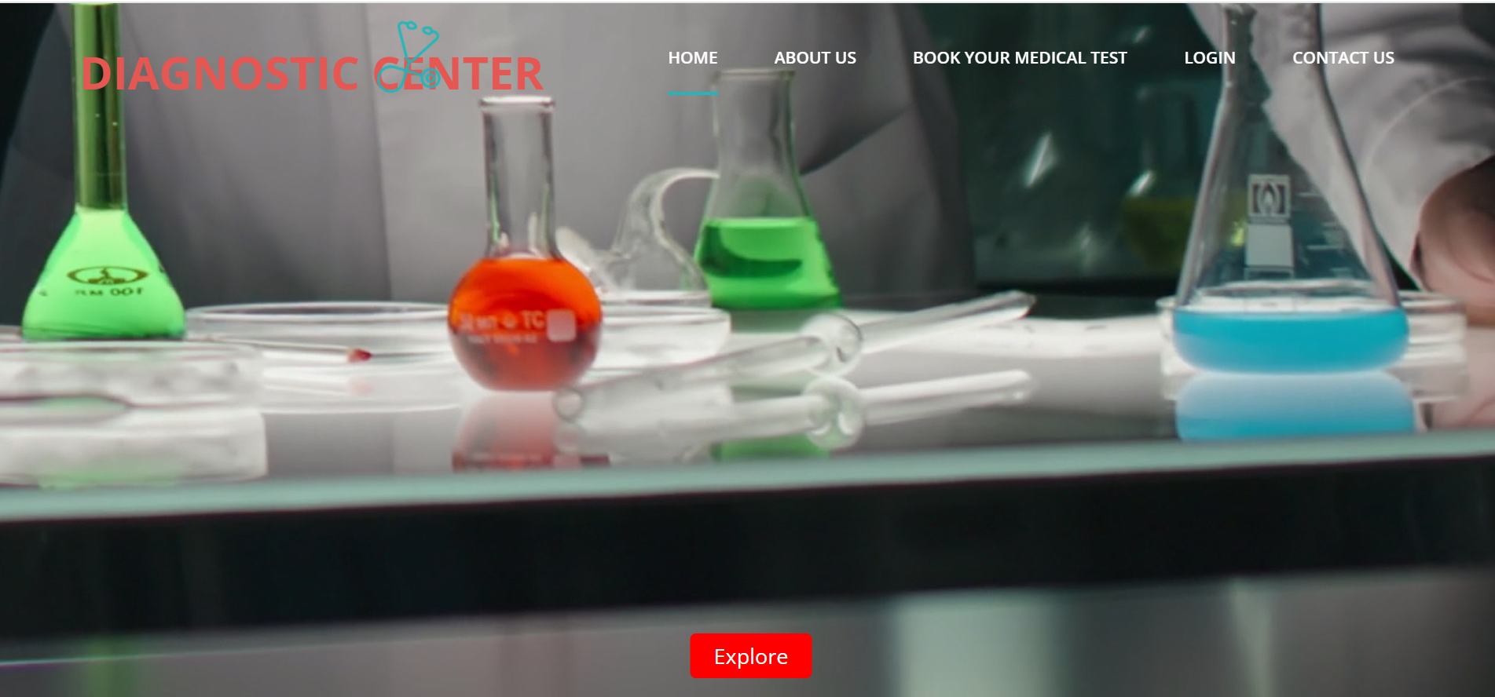
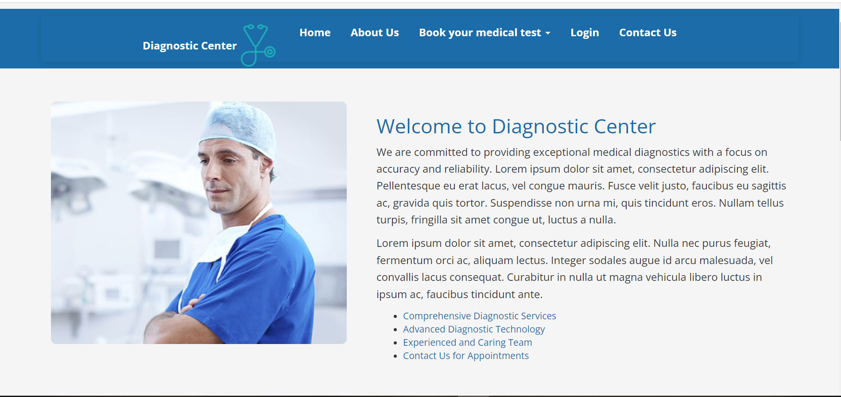
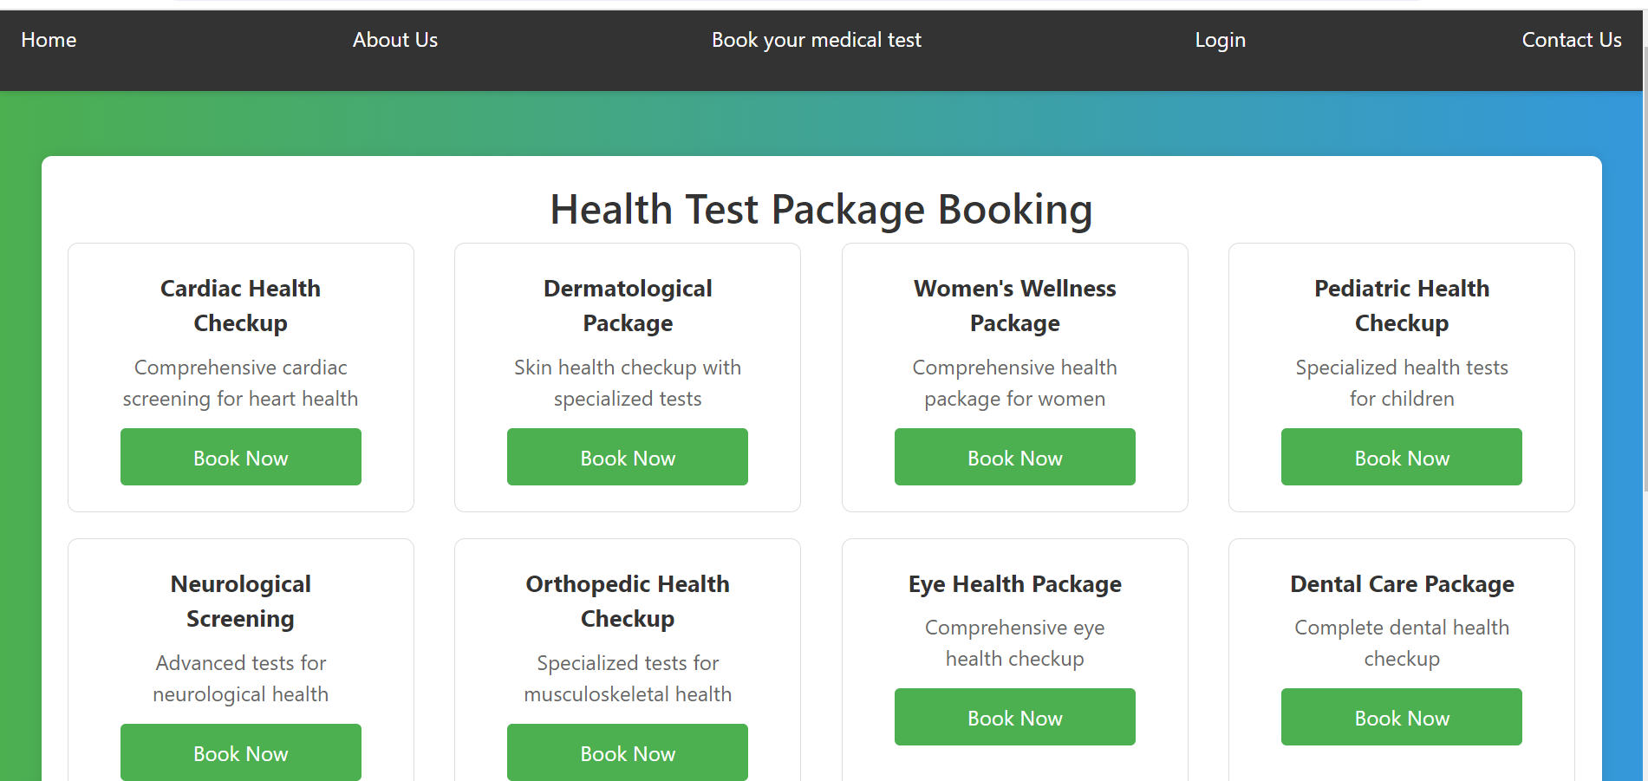
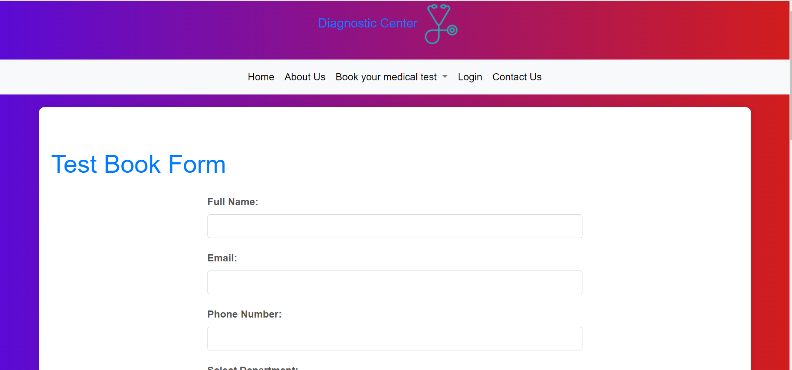
SAMPLE SCREENSHOTS
DIAGONSTIC CENTER

Slide 16
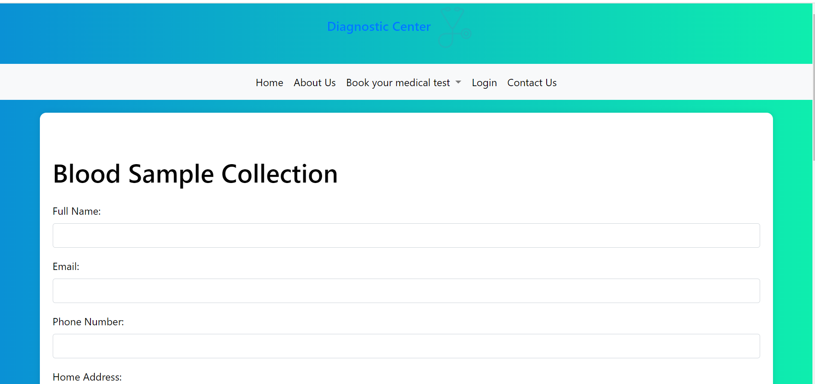
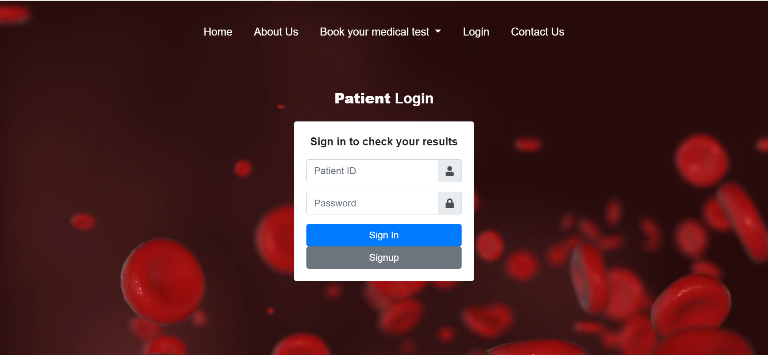
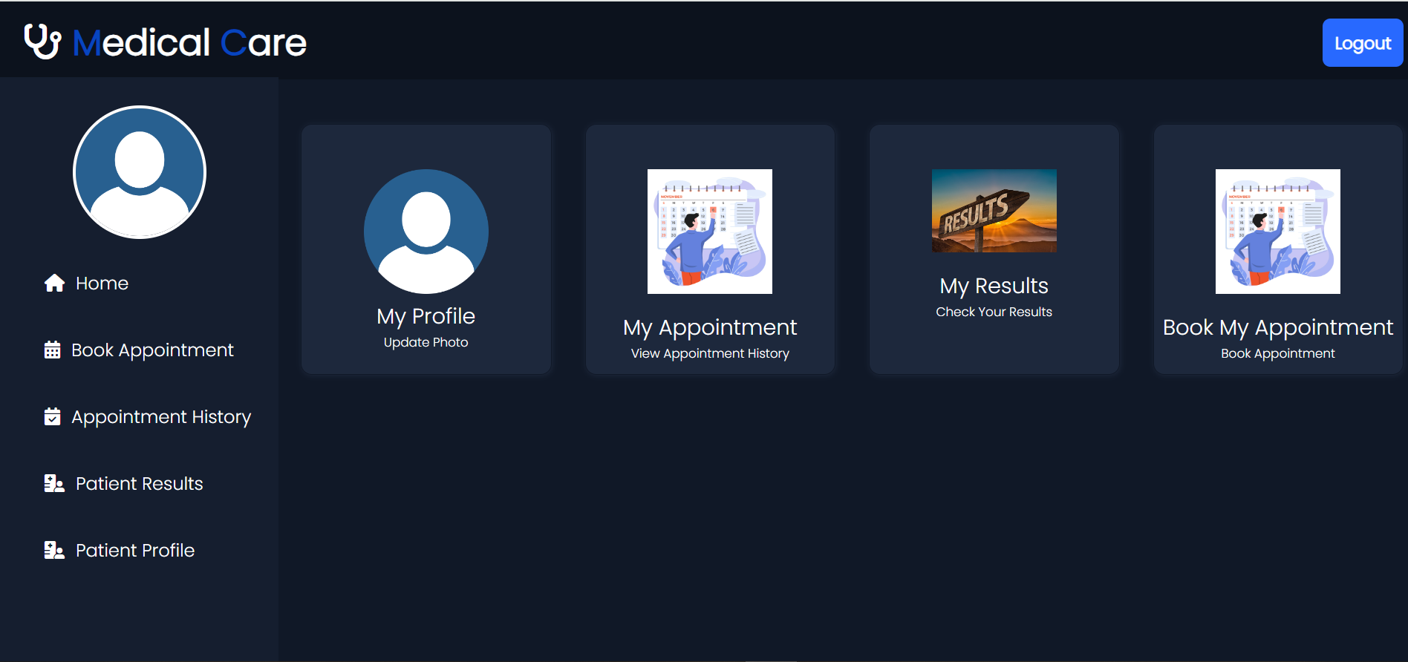
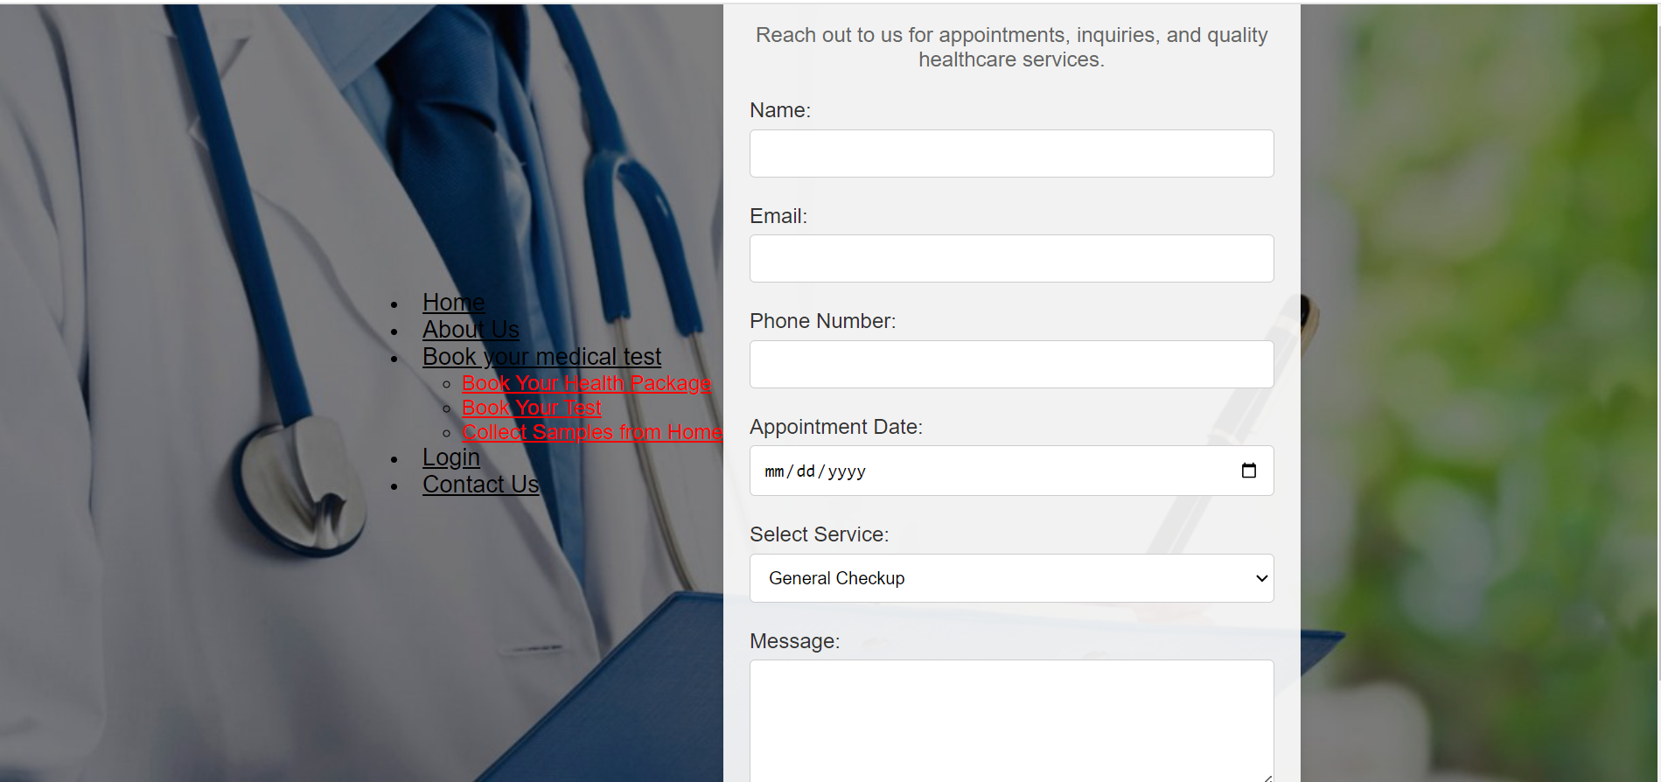
DIAGONSTIC CENTER

Slide 17
Conclusion
DIAGONSTIC CENTER
In conclusion, the development and deployment of an online diagnostic center represent a significant advancement in healthcare accessibility and efficiency. By leveraging technologies such as HTML, CSS, JavaScript, and MySQL, we can create a user-centric platform that facilitates seamless appointment scheduling, secure data management, and prompt result retrieval.
The algorithm outlines key functionalities, ensuring a user-friendly experience for both patients and healthcare professionals. Incorporating robust security measures, regular testing, and continuous monitoring contribute to a secure and reliable system.
The deployment approach emphasizes meticulous planning, including server setup, database management, and thorough testing before and after deployment. By prioritizing user communication and documentation, we foster a transparent and informed user experience.
As the healthcare landscape evolves, an online diagnostic center serves as a pivotal tool in providing accessible, efficient, and secure diagnostic services. This holistic approach aligns technological innovation with healthcare needs, ultimately contributing to improved patient outcomes and enhanced healthcare delivery.

Slide 18
Future Scope
DIAGONSTIC CENTER
The future of online diagnostic centers envisions a healthcare landscape driven by cutting-edge technologies. With the integration of AI, telemedicine, wearable devices, and personalized medicine, these centers are poised to offer more accurate diagnostics, remote healthcare access, and tailored treatment plans. The focus on data security, user experience, and global accessibility positions online diagnostic centers as pivotal players in the evolution of healthcare delivery.

Slide 19
DIAGONSTIC CENTER
References
GitHub Reference :
http://www.oreilly.com/data/free/the-new-artificial-intelligence-market.csp
Notes:
Reference
These are the references for this session.
19

Slide 20
DIAGONSTIC CENTER
Thank you!
Notes:
thank you very much for joining this PPT, keep learning.
20

